Slide 1

MOTORCYCLE RENTAL
DATABASE MANAGEMENT SYSTEM

Slide 2
Abstract
The Motorcycle Rental Database Management System is designed to manage motorcycle rental operations efficiently. It stores and processes data related to users, motorcycles, rentals, and payments, ensuring smooth transactions and record-keeping.

Slide 3
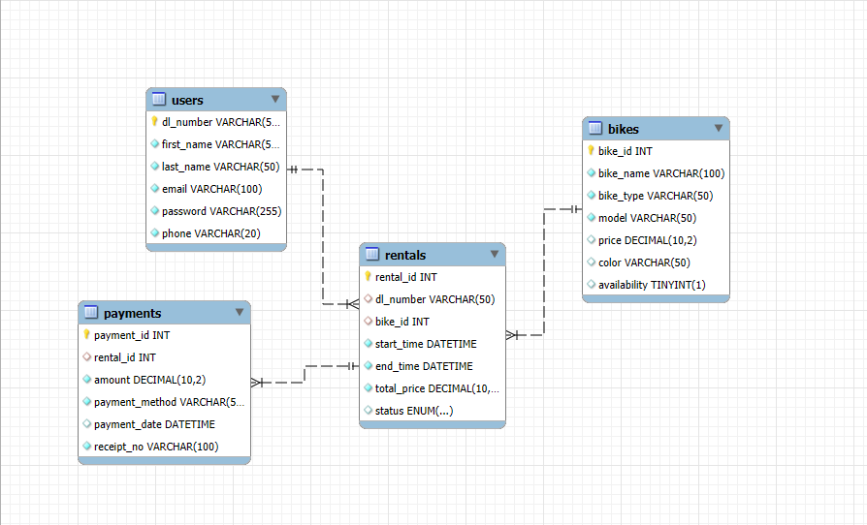
ER – DIAGRAM

Slide 4
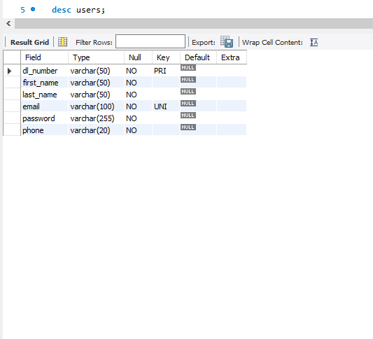
STRUCTURE OF EACH TABLE
USERS TABLE –
Stores user details including driving license number, name, email, and contact information.
Syntax : desc users;

Slide 5
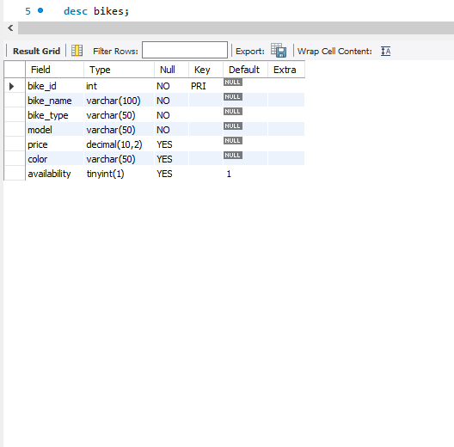
2. BIKES TABLE –
Contains information about available motorcycles, including model, type, price, and availability status.
Syntax : desc bikes;

Slide 6
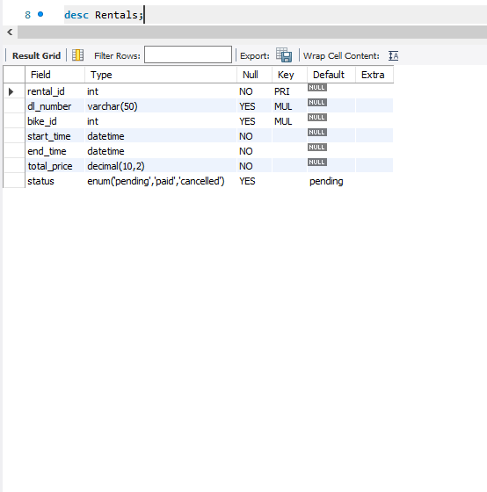
3. RENTALS TABLE –
Records bike rental transactions, linking users to rented bikes with rental duration and status.
Syntax : desc rentals;

Slide 7
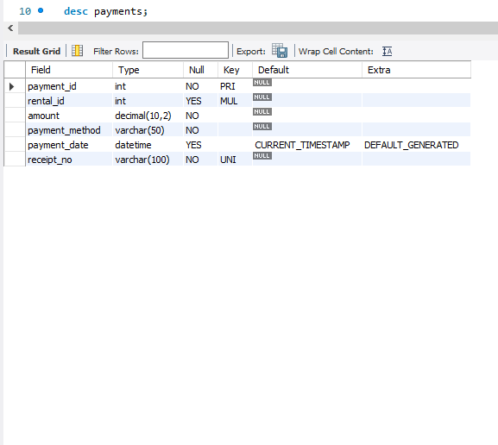
4. PAYMENTS TABLE –
Stores payment details for rentals, including amount, payment method, and receipt information.
Syntax : desc payments;

Slide 8
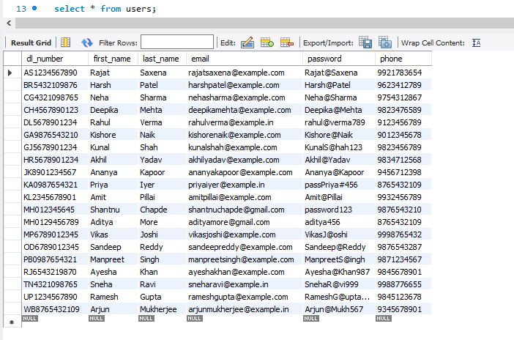
CONTENTS OF EACH TABLE
USERS TABLE
Syntax : select * from users;

Slide 9
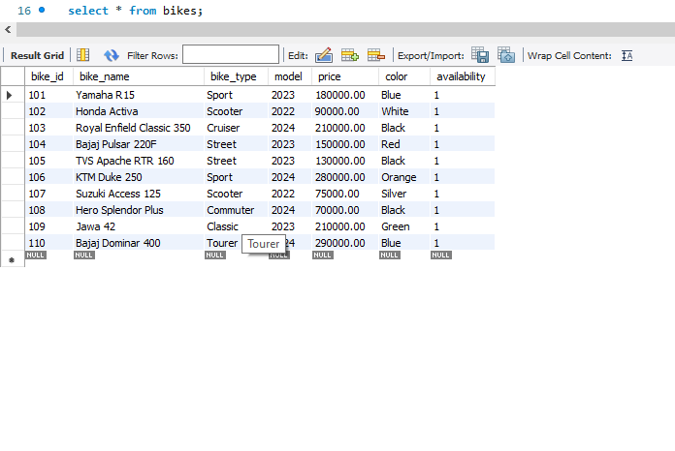
2. BIKES TABLE
Syntax : select * from bikes;

Slide 10
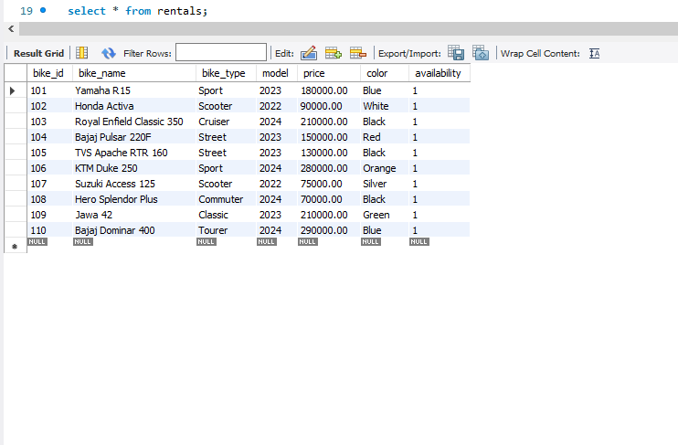
3. RENTALS TABLE
Syntax : select * from rentals;

Slide 11
4. PAYMENTS TABLE
Syntax : select * from payments;

Slide 12
SUBQUERIES

Slide 13
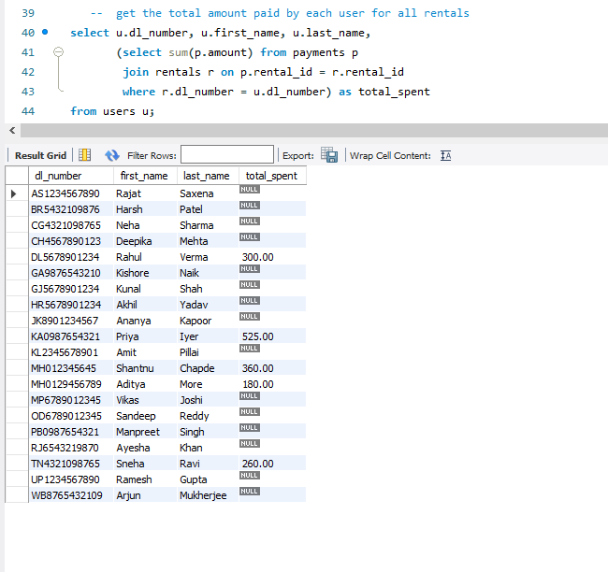
SUBQUERIES
1. Get the total amount paid by each user for all rentals.
Syntax : select u.dl_number, u.first_name, u.last_name, (select sum(p.amount) from payments p
join rentals r on p.rental_id = r.rental_id
where r.dl_number = u.dl_number) as total_spentfrom users u;

Slide 14
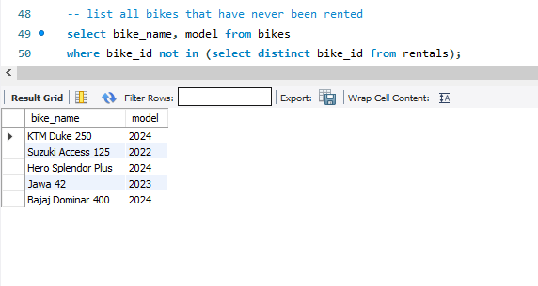
2. List all bikes that have never been rented
Syntax : select bike_name, model from bikes where bike_id not in
(select distinct bike_id from rentals);

Slide 15
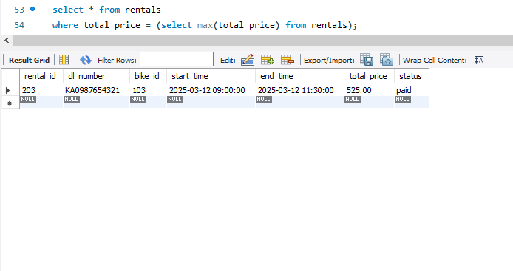
3. Find the rental with the highest total price.
Syntax : select * from rentals where total_price =
(select max(total_price) from rentals);

Slide 16
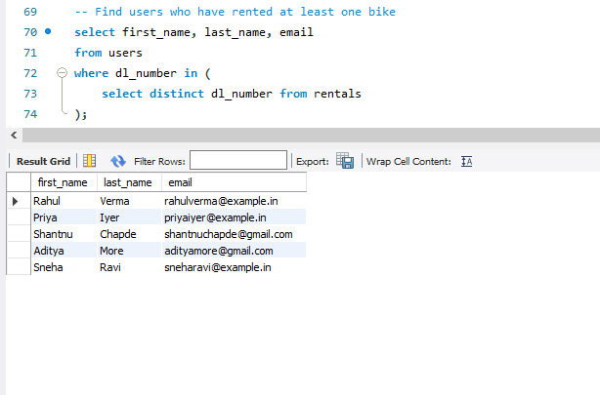
4. Find users who have rented at least one bike.
Syntax : select first_name, last_name, email from users where dl_number in
(select distinct dl_number from rentals);

Slide 17
JOINS

Slide 18
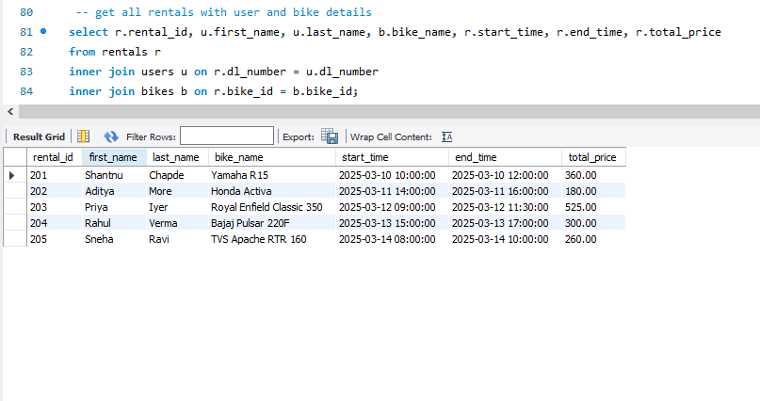
JOINS
1. Get all rentals with user and bike details
Syntax : select u.first_name, u.last_name, r.rental_id, r.start_time, r.total_pricefrom users uright join rentals r on u.dl_number = r.dl_number;

Slide 19
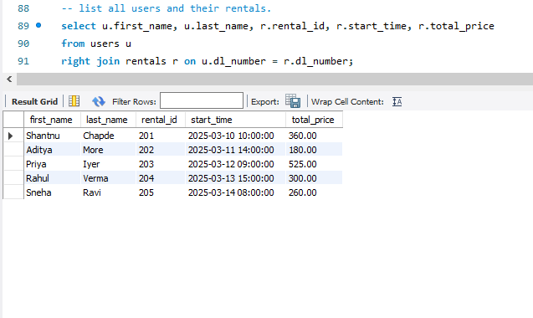
2. List all users and their rentals.
Syntax : select u.first_name, u.last_name, r.rental_id, r.start_time, r.total_price
from users uright join rentals r
on u.dl_number = r.dl_number;

Slide 20
3. List all bikes and their rentals (including bikes never rented)
Syntax : select b.bike_name, b.model, r.rental_id, r.start_time, r.total_pricefrom rentals r
right join bikes b
on r.bike_id = b.bike_id;

Slide 21
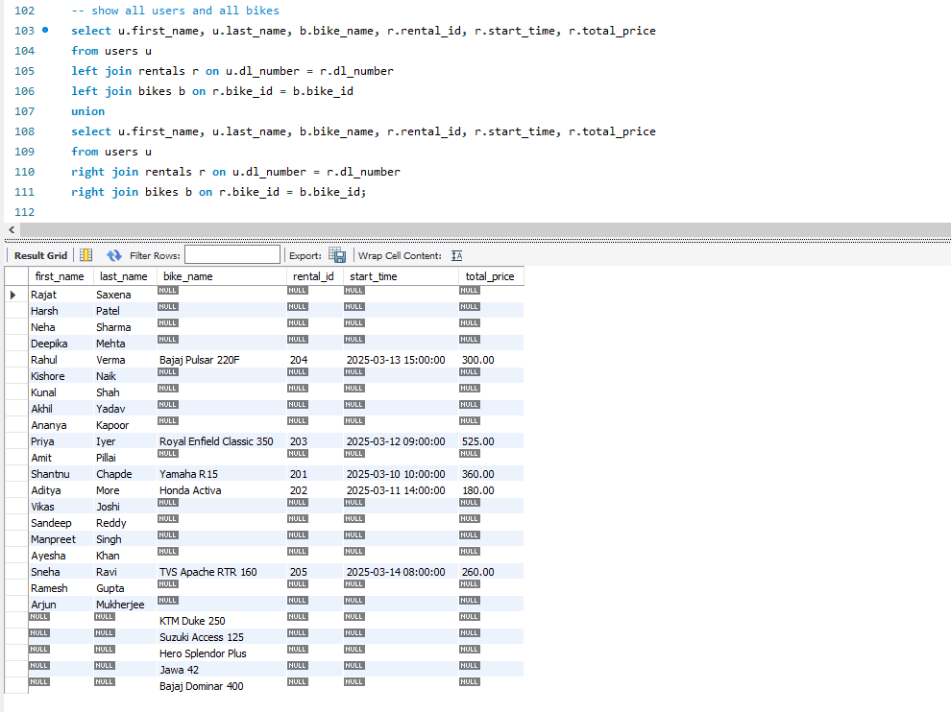
4. Show all users and all bikes
Syntax : select u.first_name, u.last_name, b.bike_name, r.rental_id, r.start_time, r.total_price from users u
left join rentals r on u.dl_number = r.dl_number
left join bikes b on r.bike_id = b.bike_id union
select u.first_name, u.last_name, b.bike_name, r.rental_id, r.start_time, r.total_price
from users u right join rentals r on u.dl_number = r.dl_number right join bikes b on r.bike_id = b.bike_id;

Slide 22
VIEWS

Slide 23
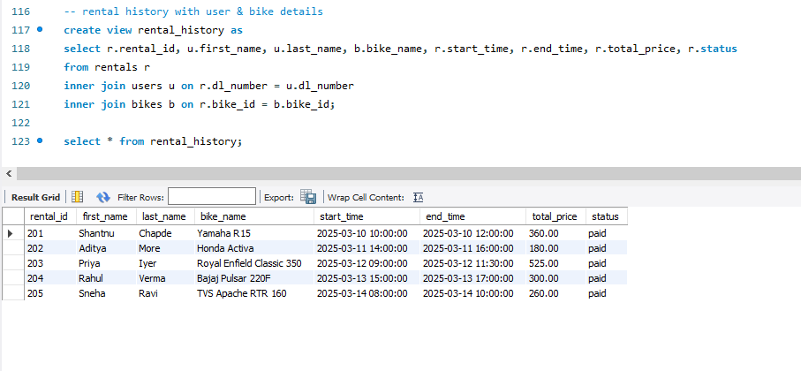
VIEWS
1. Rental history with user & bike details
Syntax : create view rental_history as
select r.rental_id, u.first_name, u.last_name, b.bike_name, r.start_time, r.end_time, r.total_price, r.status
from rentals r inner join users u on r.dl_number = u.dl_number
inner join bikes b on r.bike_id = b.bike_id;

Slide 24
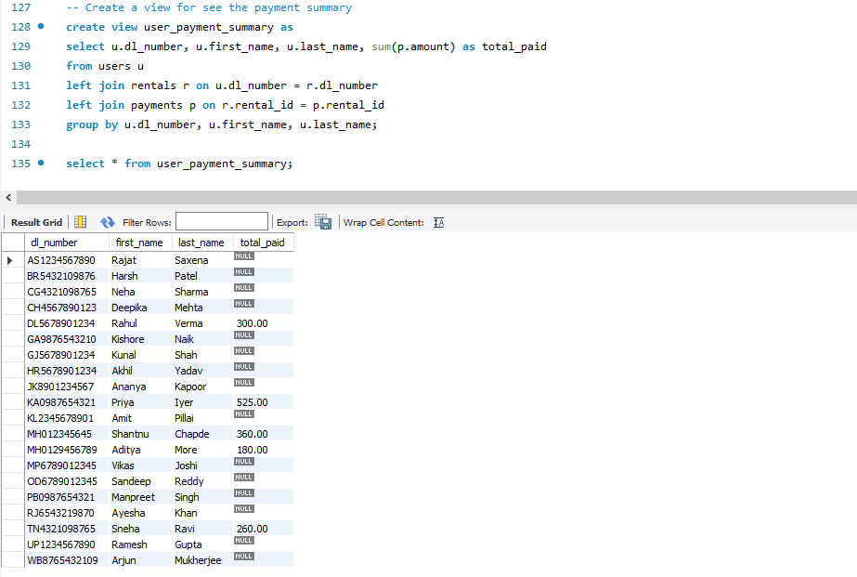
2. Create a view for see the payment summary
Syntax : create view user_payment_summary as
select u.dl_number, u.first_name, u.last_name, sum(p.amount) as total_paid from users u
left join rentals r on u.dl_number = r.dl_number
left join payments p on r.rental_id = p.rental_id
group by u.dl_number, u.first_name, u.last_name;

Slide 25

PREPARED BY :
YUVRAJ CHEDNVANKAR
IT VEDANT

Slide 26

THANK YOU

